Slide 1
Agile Models
7/18/2020

Slide 2
What is Agile Software Development?
Agile: Easily moved, light, nimble, active software processes
How agility achieved?
  Fitting the process to the project
  Avoidance of things that waste time

Slide 3
Agile Model
To overcome the shortcomings of the waterfall model of development.
  Proposed in mid-1990s
The agile model was primarily designed:
  To help projects to adapt to change requests
In the agile model:
  The requirements are decomposed into many small incremental parts
that can be developed over one to four weeks each.

Slide 4
Ideology: Agile Manifesto
Individuals and interactions over
  process and tools
Working Software over
  comprehensive documentation
Customer collaboration over
  contract negotiation
Responding to change over
  following a plan
http://www.agilemanifesto.org

Slide 5
What is “Agility”?
Effective (rapid and adaptive) response to change (team members, new technology, requirements)
Effective communication in structure and attitudes among all team members, technological and business people, software engineers and managers.
Drawing the customer into the team. Eliminate “us and them” attitude. Planning in an uncertain world has its limits and plan must be flexible.
Organizing a team so that it is in control of the work performed.
Eliminate all but the most essential work products and keep them lean.
Emphasize an incremental delivery strategy as opposed to intermediate products that gets working software to the customer as rapidly as feasible.

Slide 6
Why and What Steps are“Agility” important?
Why? The modern business environment is fast-paced and ever-changing. It represents a reasonable alternative to conventional software engineering for certain classes of software projects. It has been demonstrated to deliver successful systems quickly.
What? May be termed as “software engineering lite” The basic activities- communication, planning, modeling, construction and deployment remain. But they morph into a minimal task set that push the team toward construction and delivery sooner.
The only really important work product is an operational “software increment” that is delivered.

Slide 7
Agile Methodologies
XP
Scrum
Unified process
Crystal
DSDM
Lean

Slide 8
Agile Model: Principal Techniques
User stories:
– Simpler than use cases.
Metaphors:
  Based on user stories, developers propose a common vision of what is required.
Spike:
  Simple program to explore potential solutions.
Refactor:
– Restructure code without affecting behavior, improve efficiency, structure, etc.

Slide 9
At a time, only one increment is planned, developed, deployed at the customer site.
– No long-term plans are made.
An iteration may not add significant functionality,
  But still a new release is invariably made at the end of each iteration
  Delivered to the customer for regular use.
7

Slide 10
Methodology
Face-to-face communication favoured over written documents.
To facilitate face-to-face communication,
  Development team to share a single office space.
  Team size is deliberately kept small (5-9 people)
  This makes the agile model most suited to the development of small projects.

Slide 11
Face-to-face at whiteboard
Effectiveness of Communication Modes
Face-to-face conversation
Communication Effectiveness
Video conversation
Phone conversation
Modeling Options
Videotape Email
conversation
Audiotape
Documentation Options
Paper
Cold
Richness of Communication Channel
Copyright 2002-2005 Scott W. Ambler Original Diagram Copyright 2002 Alistair Cockburn
Hot

Slide 12
Agile Model: Principles
The primary measure of progress:
  Incremental release of working software
Important principles behind agile model:
  Frequent delivery of versions --- once every few weeks.
  Requirements change requests are easily accommodated.
  Close cooperation between customers and developers.
  Face-to-face communication among team members.
10

Slide 13
Agile Documentation
Travel light:
– You need far less documentation than you think.
Agile documents:
  Are concise
  Describe information that is less likely to change
  Describe “good things to know”
  Are sufficiently accurate, consistent, and detailed
Valid reasons to document:
  Project stakeholders require it
  To define a contract model
  To support communication with an external group
  To think something through
11

Slide 14
Agile Software Requirements Management
High Priority
Each iteration implement the highest- priority requirements
{
Each new requirement is prioritized and added to the stack
Requirements may be reprioritized at any time
Requirements may be removed at any time
Low Priority
Requirements
Copyright 2004 Scott W. Ambler

Slide 15
Adoption Detractors
Sketchy definitions, make it possible to have
  Inconsistent and diverse definitions
High quality people skills required
Short iterations inhibit long-term perspective
Higher risks due to feature creep:
  Harder to manage feature creep and customer expectations
  Difficult to quantify cost, time, quality.

Slide 16
Agile Model Shortcomings
Derives agility through developing tacit knowledge within the team, rather than any formal document:
  Can be misinterpreted…
  External review difficult to get…
  When project is complete, and team disperses, maintenance becomes difficult…

Slide 17
Agile Model versus Iterative Waterfall Model
The waterfall model steps through in a planned sequence:
  Requirements-capture, analysis, design, coding, and testing .
Progress is measured in terms of delivered artefacts:
  Requirement specifications, design documents, test plans, code reviews, etc.
In contrast agile model sequences:
  Delivery of working versions of a product in several increments.

Slide 18
Agile Model versus Iterative Waterfall Model
As regards to similarity:
– We can say that Agile teams use the waterfall model on a small scale.

Slide 19
Extreme Programming (XP)
7/18/2020

Slide 20
Extreme Programming Model
Extreme programming (XP) was proposed by Kent Beck in 1999.
The methodology got its name from the fact that:
  Recommends taking the best practices to extreme levels.
  If something is good, why not do it all the time.

Slide 21
If code review is good:
– Always review --- pair programming
If testing is good:
Taking Good Practices to Extreme
– Continually write and execute test cases --- test-driven development
If incremental development is good:
  Come up with new increments every few days
If simplicity is good:
  Create the simplest design that will support only the currently required functionality.

Slide 22
Taking to Extreme
If design is good,
– everybody will design daily (refactoring)
If architecture is important,
  everybody will work at defining and refining the architecture (metaphor)
If integration testing is important,
  build and integrate test several times a day (continuous integration)

Slide 23
4 Values
Communication:
– Enhance communication among team members and with the
customers.
Simplicity:
  Build something simple that will work today rather than something that
takes time and yet never used
  May not pay attention for tomorrow
Feedback:
  System staying out of users is trouble waiting to happen
Courage:
  Don’t hesitate to discard code

Slide 24
Best Practices
Coding:
without code it is not possible to have a working system.
Utmost attention needs to be placed on coding.
Testing:
  Testing is the primary means for developing a fault-free product.
Listening:
  Careful listening to the customers is essential to develop a good quality product.

Slide 25
An Agile Process
Is driven by customer descriptions of what is required (scenarios). Some assumptions:
  Recognizes that plans are short-lived (some requirements will persist, some will change. Customer priorities will change)
  Develops software iteratively with a heavy emphasis on construction activities (design and construction are interleaved, hard to say how much design is necessary before construction. Design models are proven as they are created. )
  Analysis, design, construction and testing are not predictable.
Thus has to Adapt as changes occur due to unpredictability
Delivers multiple ‘software increments’, deliver an operational prototype or portion of an OS to collect customer feedback for adaption.

Slide 26
Agility Principles - I
1. Our highest priority is to satisfy the customer through early and continuous delivery of valuable software.
2. Welcome changing requirements, even late in development. Agile processes harness change for the customer's competitive advantage.
3. Deliver working software frequently, from a couple of weeks to a couple of months, with a preference to the shorter timescale.
4. Business people and developers must work together daily throughout the project.
5. Build projects around motivated individuals. Give them the environment and support they need, and trust them to get the job done.
6. The most efficient and effective method of conveying information to and within a development team is face–to–face conversation.

Slide 27
Agility Principles - II
7. Working software is the primary measure of progress.
8. Agile processes promote sustainable development. The sponsors, developers, and users should be able to maintain a constant pace indefinitely.
9. Continuous attention to technical excellence and good design enhances agility.
10. Simplicity – the art of maximizing the amount of work not done – is essential.
11. The best architectures, requirements, and designs emerge from self–organizing teams.
12. At regular intervals, the team reflects on how to become more effective, then tunes and adjusts its behavior accordingly.

Slide 28
Human Factors
The agile process molds to the needs of the people and team, not the other way around
Key traits must exist among the people on an agile team and the team itself:
  Competence. ( talent, skills, knowledge)
  Common focus. ( deliver a working software increment )
  Collaboration. ( peers and stakeholders)
  Decision-making ability. ( freedom to control its own destiny)
  Fuzzy problem-solving ability. (ambiguity and constant changes, today’s problem may not be tomorrow’s problem)
  Mutual trust and respect.
  Self-organization. ( themselves for the work done, process for its local environment, the work schedule)
Notes:
The problem you solve today may not be needed tomorrow. This is kept in mind.

Slide 29
Extreme Programming (XP)
The most widely used agile process, originally proposed by Kent Beck in 2004.
It uses an object-oriented approach.
Planning
Design
Coding
Test

Slide 30
XP Planning
  Begins with the listening, leads to creation of “user stories” that describes required output, features, and functionality. Customer assigns a value (i.e., a priority) to each story.
  Agile team assesses each story and assigns a cost (development weeks. If more than 3 weeks, customer asked to split into smaller stories)
  Working together, stories are grouped for a deliverable increment next release.
  A commitment (stories to be included, delivery date and other project matters) is made. Three ways:
    1. Either all stories will be implemented in a few weeks, 2. high priority stories first, or 3. the riskiest stories will be implemented first.
  After the first increment “project velocity”, namely number of stories implemented during the first release is used to help define subsequent delivery dates for other increments. Customers can add stories, delete existing stories, change values of an existing story, split stories as development work proceeds.

Slide 31
XP Design
Occurs both before and after coding as refactoring is encouraged
  Follows the KIS principle (keep it simple) Nothing more nothing less than the story.
  Encourage the use of CRC (class-responsibility-collaborator) cards in an object-oriented context. The only design work product of XP. They identify and organize the classes that are relevant to the current software increment. (see Chapter 8)
  For difficult design problems, suggests the creation of “spike solutions”—a design prototype for that portion is implemented and evaluated.
  Encourages “refactoring”—an iterative refinement of the internal program design. Does not alter the external behavior yet improve the internal structure. Minimize chances of bugs. More efficient, easy to read.

Slide 32
XP Coding and Testing
XP Coding
  Recommends the construction of a unit test for a story before coding commences. So implementer can focus on what must be implemented to pass the test.
  Encourages “pair programming”. Two people work together at one workstation. Real time problem solving, real time review for quality assurance. Take slightly different roles.
XP Testing
  All unit tests are executed daily and ideally should be automated. Regression tests are conducted to test current and previous components.
  “Acceptance tests” are defined by the customer and executed to assess customer visible functionality
Notes:
Regression tests are to test new changes to the code.

Slide 33
Extreme Programming (XP)

Slide 34
The XP Debate
Requirements volatility: Customer is an active member of XP team, changes to requirements are requested informally and frequently.
Conflicting customer needs: Different customers' needs need to be assimilated. Different vision or beyond their authority.
Requirements are expressed informally: Use stories and acceptance tests are the only explicit manifestation of requirements. Formal models may avoid inconsistencies and errors before the system is built. Proponents said changing nature makes such models obsolete as soon as they are developed.
Lack of formal design: XP deemphasizes the need for architectural design. Complex systems need overall structure to exhibit quality and maintainability. Proponents said incremental nature limits complexity as simplicity is a core value.

Slide 35
Other Agile Process Models
Adaptive Software Development
Scrum
Dynamic Systems Development Method
Crystal
Agile Modeling
and more…

Slide 36
XP Planning an increment
Begins by creating “user stories”
Agile team assesses each story and assigns a cost
Few stories are grouped into a deliverable increment
Delivery date planned
Extreme Development Activities
XP Design
Follows the KIS principle
Encourage the use of CRC cards
For difficult design problems, suggests the creation of “spike solutions”—a
design prototype
Encourages “refactoring”—refinement of the internal program design
36

Slide 37
XP Coding
  Recommends the construction of unit test cases before coding
commences (test-driven development)
Encourages “pair programming”
XP Testing
  All unit tests are executed daily
Extreme Program Development Activities
“Acceptance tests” are defined by the customer and executed to assess
customer visible functionalities
37

Slide 38
Full List of XP Practices
Planning – determine scope of the next release by combining business priorities and
technical estimates
Small releases – put a simple system into production, then release new versions in very
short cycles
Metaphor – all development is guided by a simple shared story of how the whole
system works
Simple design – system is to be designed as simple as possible
Testing – programmers continuously write and execute unit tests

Slide 39
Full List of XP Practices
Refactoring – programmers continuously restructure the system without changing its behavior to remove duplication and simplify
Pair-programming -- all production code is written with two programmers at one machine
Collective ownership – anyone can change any code anywhere in the system at any time.
Continuous integration – integrate and build the system many times a day – every time a task is completed.

Slide 40
Full List of XP Practices
40-hour week – work no more than 40 hours a week as a rule
On-site customer – a user is a part of the team and available full- time to answer questions
Coding standards – programmers write all code in accordance with rules emphasizing communication through the code

Slide 41
Emphasizes Test-Driven Development (TDD)
Based on user story develop test cases
Implement a quick and dirty feature every couple of days:
  Get customer feedback
  Alter if necessary
  Refactor
Take up next feature

Slide 42
Project Characteristics that Suggest Suitability of Extreme Programming
Projects involving new technology or research projects.
  In this case, the requirements change rapidly and unforeseen technical problems need to be resolved.
Small projects:
  These are easily developed using extreme programming.

Slide 43
Practice Questions
What are the stages of iterative waterfall model?
What are the disadvantages of the iterative waterfall model?
Why has agile model become so popular?
What difficulties might be faced if no life cycle model is followed for a certain large project?

Slide 44
Suggest Suitable Life Cycle Model
A software for an academic institution to automate its:
  Course registration and grading
  Fee collection
  Staff salary
  Purchase and store inventory
The software would be developed by tailoring a similar software that was developed for another educational institution:
  70% reuse
  10% new code and 20% modification

Slide 45
Practice Questions
Which types of risks can be better handled using the spiral model compared to the prototyping model?
Which type of process model is suitable for the following projects:
  A customization software
  A payroll software for contract employees that would be add on to an existing payroll software

Slide 46
Practice Questions
Which lifecycle model would you select for the following project which has been awarded to us by a mobile phone vendor:
  A new mobile operating system by upgrading the existing operating system
  Needs to work well efficiently with 4G systems
  Power usage minimization
  Directly upload backup data on a cloud infrastructure maintained by the
mobile phone vendor

Slide 47
Scrum

Slide 48
Scrum: Characteristics
One of the agile processes
Self-organizing teams
Product development progresses in a series of month-long
sprints
Requirements are listed in a product backlog

Slide 49
Daily
Scrum
Sprint
planning
Sprint
review
Scrum
Sprint
backlog
Product backlog
Product
increment

Slide 50
Sprint
Scrum projects progress in a series of “sprints”
  Analogous to XP iterations or time boxes
  Target duration is one month
Software increment is designed, coded, and tested during a sprint
No changes entertained during a sprint

Slide 51
Sprint
Fundamental process flow of Scrum
A month-long iteration, during which an incremental product functionality completed
NO outside influence can interfere with the Scrum team during the Sprint
Each day begins with the Daily Scrum Meeting

Slide 52
Scrum Framework
Roles : Product Owner, ScrumMaster, Team
Ceremonies : Sprint Planning, Sprint Review, Sprint Retrospective, and Daily Scrum Meeting
Artifacts : Product Backlog, Sprint Backlog, and Burndown Chart

Slide 53
Key Roles and Responsibilities in Scrum Process
Product Owner
  Acts on behalf of customers to represent their interests.
Development Team
  Team of five to nine people with cross-functional skill sets.
Scrum Master (aka Project Manager)
  Facilitates scrum process and resolves impediments and acts as a buffer between the team and outside interference.

Slide 54
Product Owner
Defines the features of the product
Decides on release date and content
Prioritizes new features
Adjusts features and priority every iteration, as needed
Accepts or rejects work results.

Slide 55
The Scrum Master
Represents management
Removes impediments
Ensures that the team is fully functional and productive
Shield the team from external interferences

Slide 56
Scrum Team
Typically 5-10 people
Cross-functional
– QA, Programmers, UI Designers, etc.
Teams are self-organizing
Membership can change only between sprints

Slide 57
Ceremonies
Sprint Planning Meeting
Daily Scrum
Sprint Review Meeting

Slide 58
Sprint Planning
Goal is to produce Sprint Backlog
Product owner works with the Team to negotiate what
Backlog Items the Team will work on in order to meet
Release Goals
Scrum Master ensures Team agrees to realistic goals

Slide 59
Daily Scrum
Daily
15-minutes
Stand-up meeting
Not for problem solving
Three questions:
  What did you do yesterday
  What will you do today?
  What obstacles are in your way?

Slide 60
Daily Scrum
Is NOT a problem solving session
Is NOT a way to collect information about WHO is behind the schedule
Is a meeting in which team members make informal commitments to each other and to the Scrum Master
Is a good way for a Scrum Master to track the progress of the Team

Slide 61
Team presents what it accomplished during the sprint
Typically takes the form of a demo of new features
Informal
  2-hour prep time rule
Participants
  Customers
  Management
  Product Owner
  Other teammates
Sprint Review Meeting

Slide 62
Product Backlog
A list of all desired work on the project
  Usually a combination of
    story-based work (“allow user to search and replace”)
    task-based work (“improve exception handling”)
List is prioritized by the Product Owner.

Slide 63
Product Backlog
Requirements for a system, expressed as a prioritized list of Backlog Items
  Managed and owned by Product Owner
  Spreadsheet (typically)

Slide 64
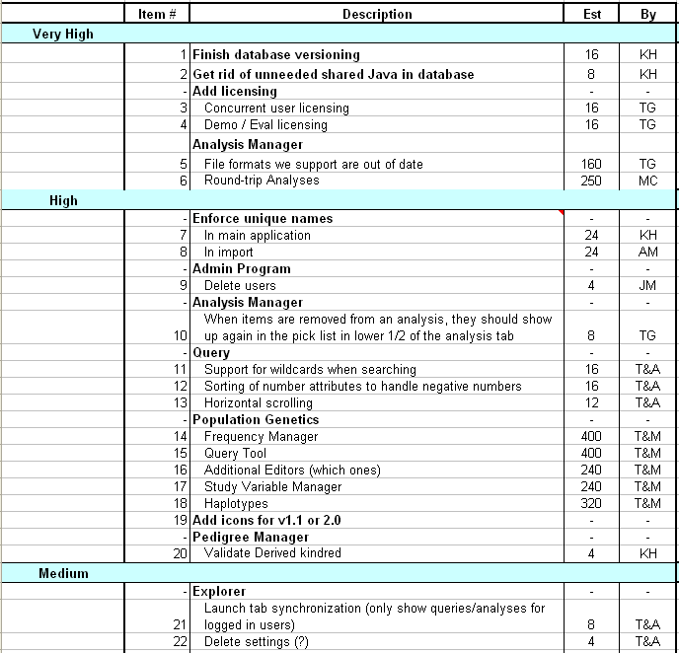
Sample
Product Backlog

Slide 65
Sprint Backlog
A subset of Product Backlog Items, which define the work for a Sprint
  Created by Team members
  Each Item has it’s own status
  Updated daily

Slide 66
Sprint Backlog during the Sprint
Changes occur:
  Team adds new tasks whenever they need to in order to meet the Sprint Goal
  Team can remove unnecessary tasks
  But: Sprint Backlog is only updated by the team
Estimates are updated whenever there’s new information

Slide 67
Burn down Charts
Are used to represent “work done”.
Are remarkably simple but effective Information disseminators
Three Types:
  Sprint Burn down Chart (progress of the Sprint)
  Release Burn down Chart (progress of release)
  Product Burn down chart (progress of the Product)

Slide 68
Sprint Burn down Chart
Depicts the total Sprint Backlog hours remaining per day
Shows the estimated amount of time to complete
Ideally should burn down to zero to the end of the Sprint
Usually is not a straight line

Slide 69
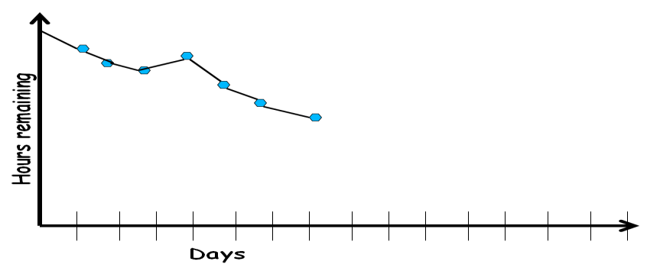
Sprint Burndown Chart

Slide 70
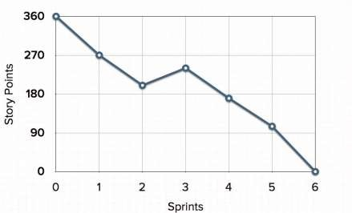
Release Burndown Chart
Will the next release be done on right time?
How many more sprints?
X-axis: sprints
Y-axis: amount of story points remaining

Slide 71
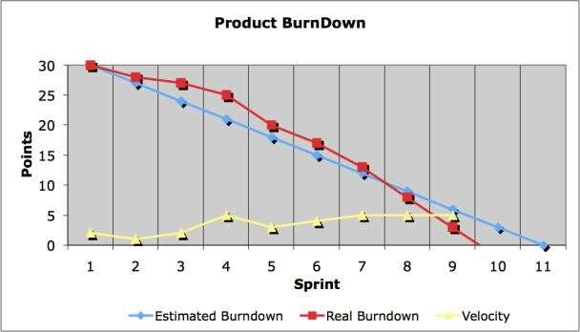
Product Burndown Chart
Is a “big picture” view of project’s progress (all the releases)

Slide 72
Scalability of Scrum
A typical Scrum team is 6-10 people
Jeff Sutherland proposed and experimented with up to over 800 people
"Scrum of Scrums" also called "Meta-Scrum“

Slide 73
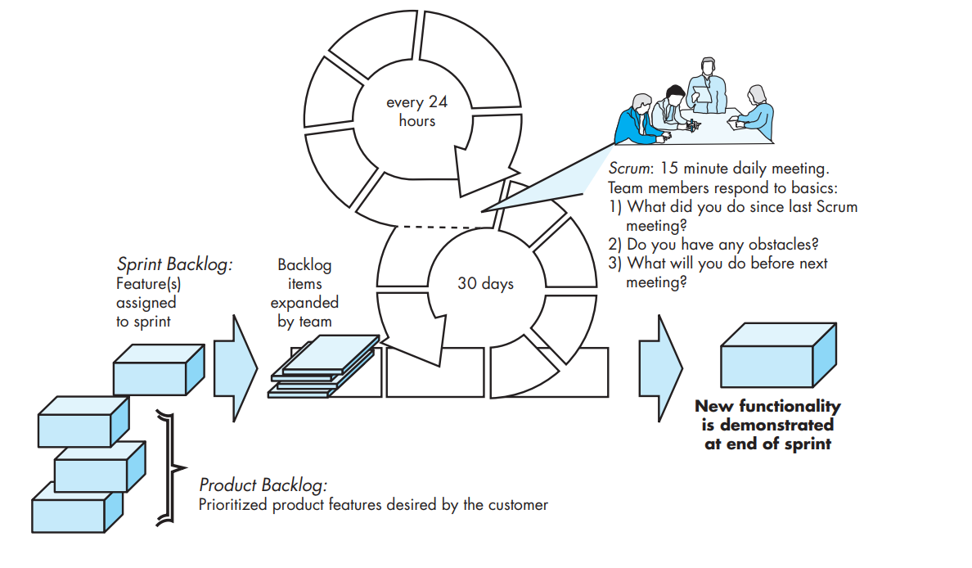

Slide 74
Requirements Analysis and Specification
RAJIB MALL
Computer Science and Engineering Department
IIT KHARAGPUR

Slide 75
What are Requirements?
A Requirement is:
–
A capability or condition required from the system.
What is involved in requirements analysis and specification?
  Determine what is expected by the client from the system. (Gather and Analyze)
  Document those in a form that is clear to the client as well as to the
development team members. (Document)

Slide 76
Understanding and specifying requirements
For toy problems: understanding and specifying requirements is rather easy…
For industry-standard problems: Probably the hardest, most problematic and error prone among development tasks…
The task of requirements specification :
  Input: User needs that are hopefully fully understood by the users.
  Output: Precise statement of what the software will do.

Slide 77
Requirements for Products
When a company plans to develop a generic product:
– Who gives the requirements?
The sales personnel!

Slide 78
Requirements Gathering
Activities in Requirements Analysis and Specification
Requirements Analysis
Requirements Specification
SRS Document

Slide 79
Requirements Engineering Process
Feasibility
Study
Requirements
gathering
Requirements
analysis
Feasibility
report
Requirements
specification
SRS Document

Slide 80
Requirements Analysis and Specification
Requirements Gathering:
  Fully understand the user requirements.
Requirements Analysis:
  Remove inconsistencies, anomalies, etc. from requirements.
Requirements Specification:
  Document requirements properly in an SRS document.

Slide 81
Good SRS reduces development cost:
– Req. errors are expensive to fix later
Need for SRS…
Req. changes cost a lot (typically 40% of requirements change later)
Good SRS can minimize changes and errors
Substantial savings --- effort spent during req. saves multiple times that effort
An Example:
– Cost of fixing errors in req. , design , coding , acceptance testing and operation increases exponentially
Cost

Slide 82
Establishes the basis for agreement between the
What are the Uses of an SRS Document?
customers and the suppliers
Forms the starting point for development.
Provide a basis for estimating costs and schedules.
Provide a basis for validation and verification.
Provide a basis for user manual preparation.
Serves as a basis for later enhancements.

Slide 83
Forms A Basis for User Manual
The SRS serves as the basis for writing User Manual for the software:
  User Manual: Describes the functionality from the perspective of a user --- An important document for users.
  Typically also describes how to carry out the required tasks with examples.

Slide 84
SRS Document: Stakeholders
SRS intended for a diverse audience:
  Customers and users use it for validation, contract, ...
  Systems (requirements) analysts
  Developers, programmers to implement the system
  Testers use it to check whether requirements have been met
  Project Managers to measure and control the project
Different levels of detail and formality is needed for each audience
Different templates for requirements specifications used by companies:
  Often variations of IEEE 830

Slide 85
Requirement process..
User needs
Specification and review may lead to further gathering and analysis.
Gathering
Analysis
Specification
Review
SRS Document

Slide 86

Faculty Name
Department Name
74

